Slide 1
Tech-update
Team Members:
Sabareeswaran s(16bit005)
NISHANTH m(16bit033)
Rakunanthan k s(16bit021)

Slide 2
Problem Statement:
The updates in the Technology and Electronic Gadgets are complex to find in a single webpage.
The comparison of the specifications as well as price is also complex.

Slide 3
Solution:
The updates in the Technology are updated in the web page when the organisation officially releases the update.
The Electronic gadgets which are introduced recently are also updated in the webpage.
It is easy to find all the updates in a single web page.

Slide 4
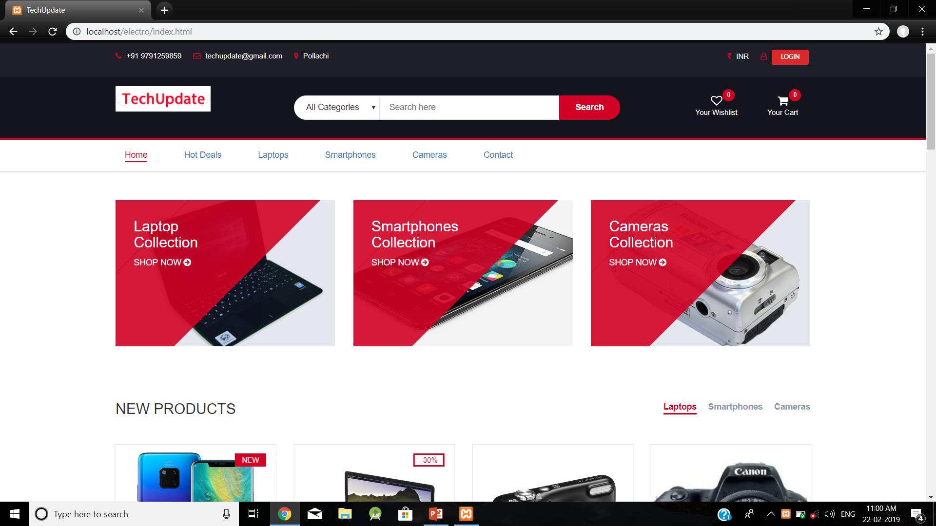
Home page:

Slide 5
Home page:
The categories of the available products are displayed in the home page.
The user can select the category and view the products.
The new products are also displayed as a suggestion in the home page.

Slide 6
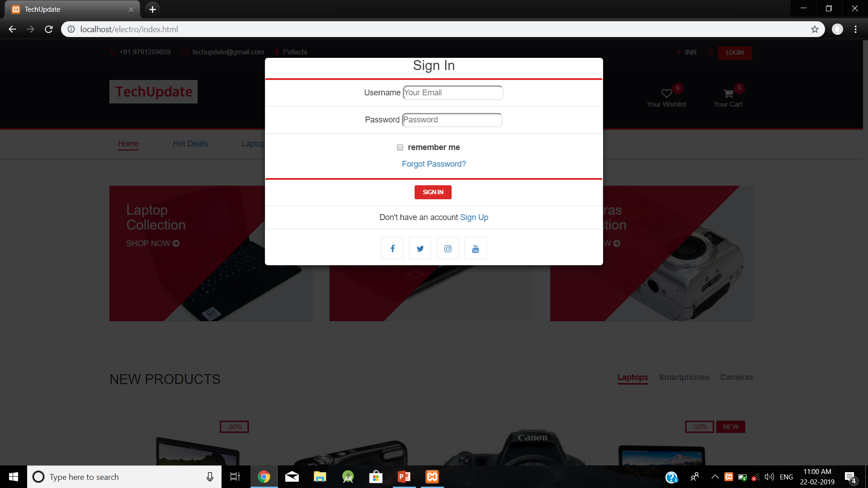
User login:

Slide 7
Login page:
The login page has both sign in and signup for the user.
If the user is new user, the user have to sign up in the application and have to login with the registered username and password.

Slide 8
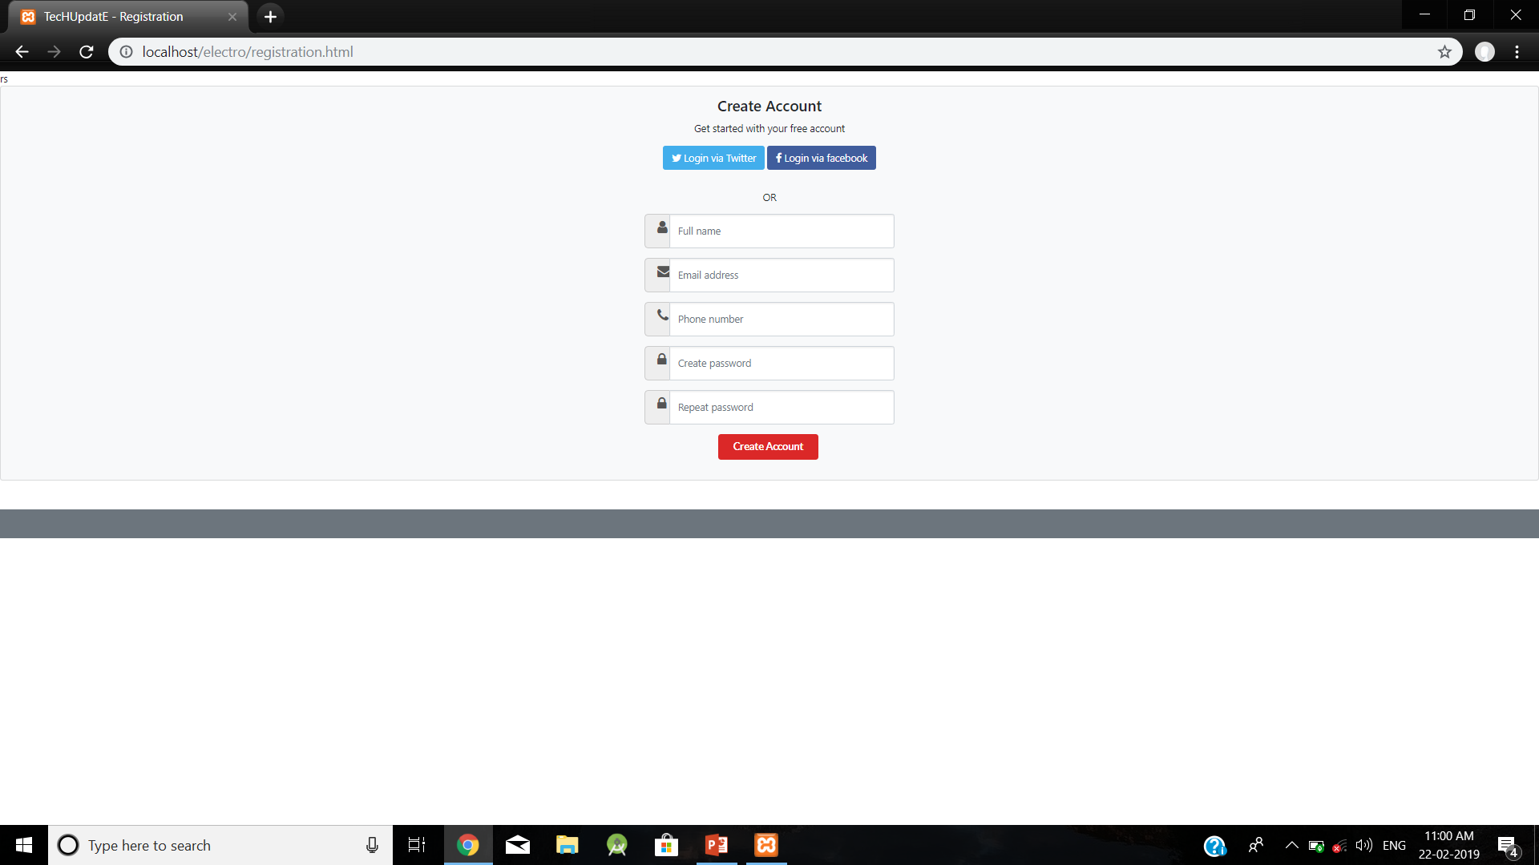
Signup page:

Slide 9
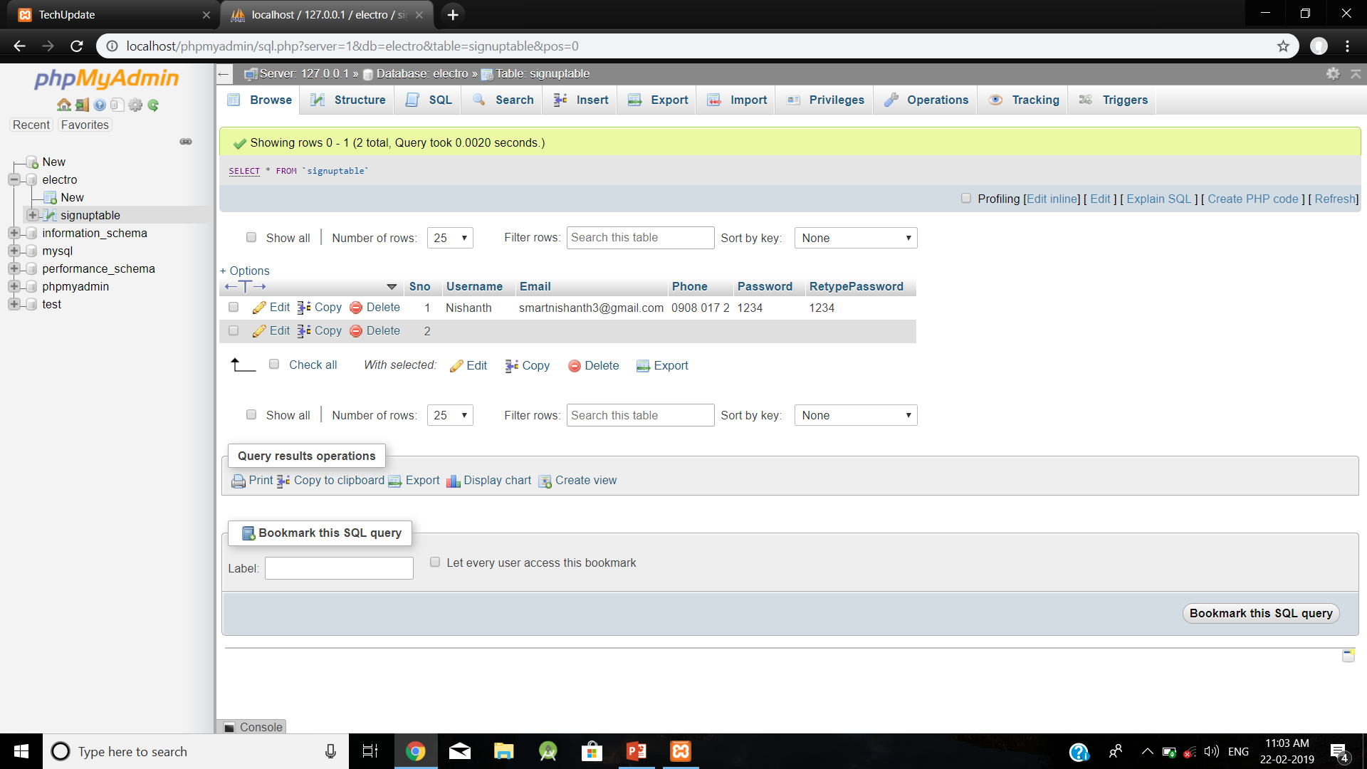
User details stored in database:

Slide 10
Database:
If the new user has been registered in the application, the user details such as name, email, mobile.no, password has been stored in the database.
The details should be used for the user’s further login verifications.

Slide 11
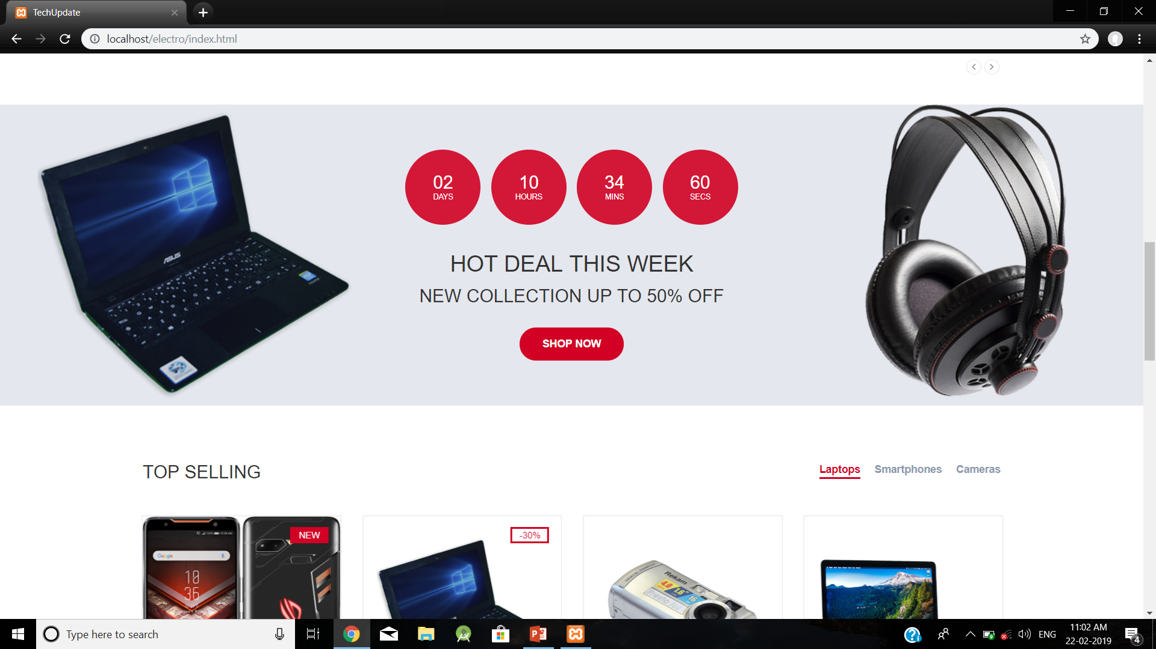
Special offers:

Slide 12
Special Deals of the day:
The special deals of the day are displayed in the home page.
The deals have some limited time period and the deals disapper after the time exceeds.

Slide 13
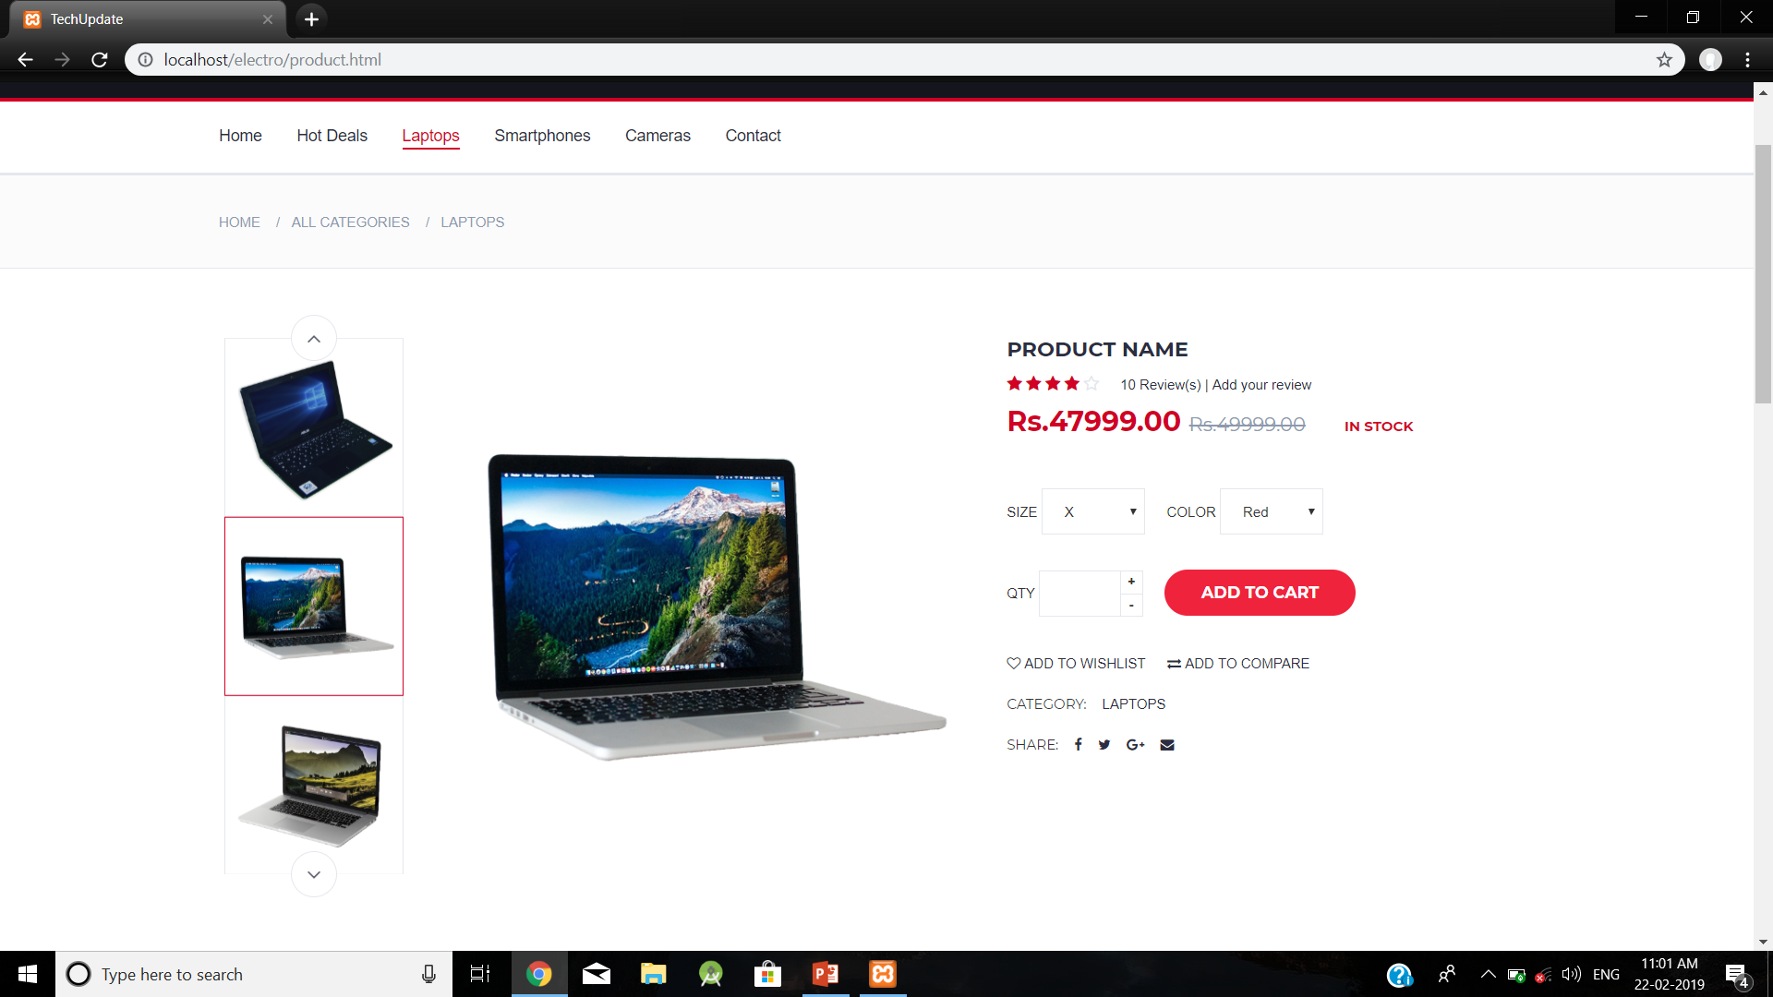
Laptops section:

Slide 14
Laptops section:
The laptops of several brands are displayed.
The actual price and the offer price are displayed.
The user or the customer can give their reviews based on the purchased product.

Slide 15
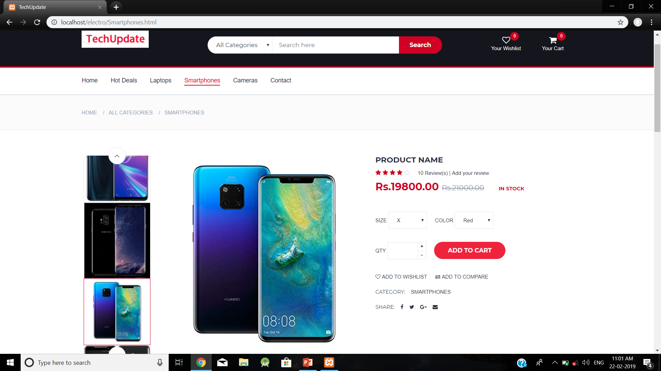
Smartphones section:

Slide 16
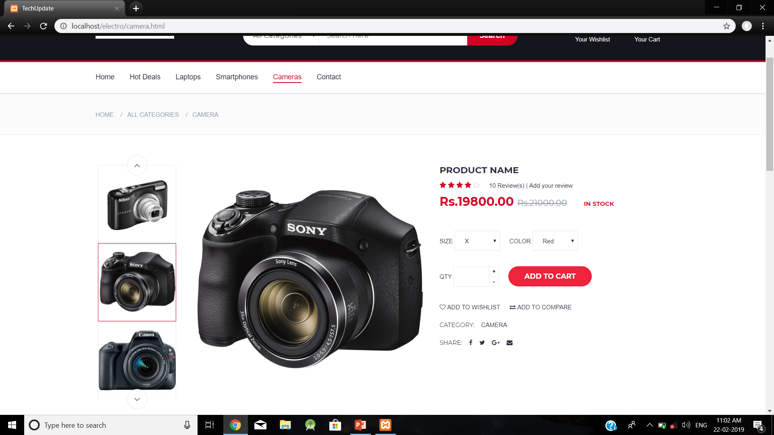
Cameras section:

Slide 17
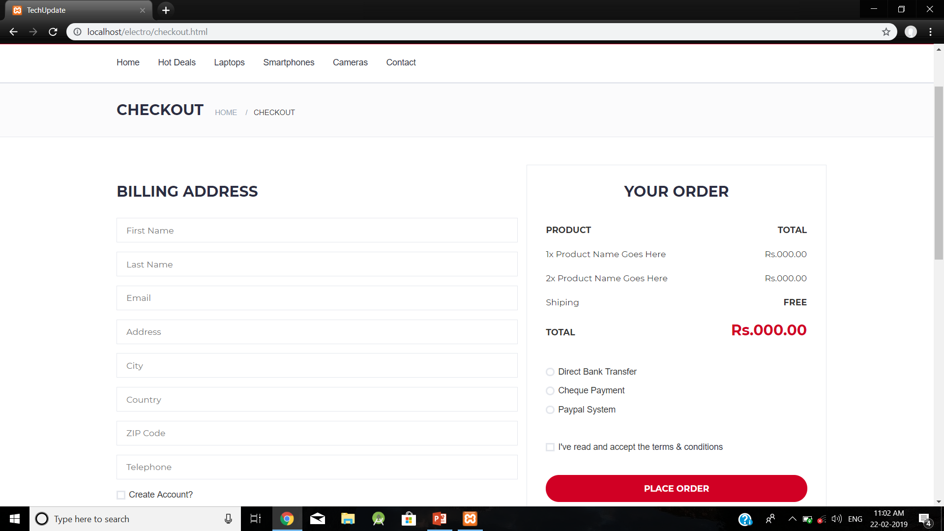
Checkout:

Slide 18
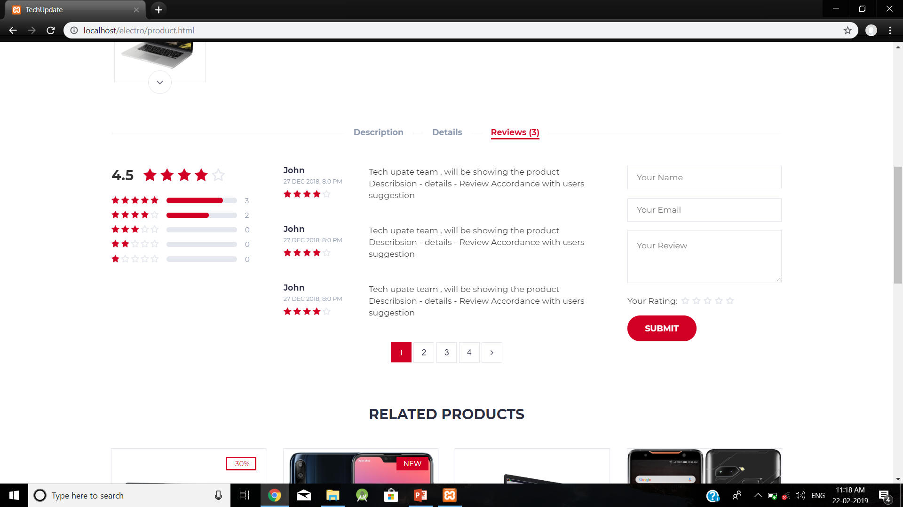
User reviews:

Slide 19
Front end:
HTML
CSS
BOOTSTRAP
JQUERY

Slide 20
BACK END:
XAMPP
SQLite
Php
MySQL

Slide 21
THANK YOU

